Slide 1

Network Optimization Analysis & Comparison
Authors: Aaron Werth, Alan Tate, Derek Nelson, Spencer Kirksey

Slide 2

Network Optimization Concept
Networks use routing to find the best path between two locations in a network, with the locations either being in computer network or a transportation system.
Networks can be represented and modeled as graphs by using the following:
Nodes being represented as routers, switches, or locations
Edges representing the communication links or roads
We will be using four algorithms to compare different types of networking routes and finding the most efficient uses of the algorithms.

Slide 3
Objective
We will be analyzing 4 algorithms to find the best networking efficiency.
Dijkstra's Algorithm
Bellman-Ford Algorithm
A* Search Algorithm
Harmony Search Algorithm
We will use 3 implementations for this research. Two of these implementations will be in Python and one will be in C++. Will we be comparing one of the Python implementations to the C++ implementation too see which code will be more efficient. Meanwhile the other Python implementation will be used to compare the algorithms on real-world datasets to see how their efficiencies differ.

Slide 4
Dijkstra Analysis
Analysis Topic | Analysis Value
Time Complexity | Θ(E + V log V)
Strengths | Efficient on sparse graphs, well-supported on standard libraries
Weaknesses | Requires non-negative, does not generalize multi-objective or dynamic routing

Slide 5
Bellman-Ford Analysis
Analysis Topic | Analysis Value
Time Complexity | Θ(V · E) (worst case)
Strengths | Handles negative edge weights, detects negative cycles
Weaknesses | Slower than Dijkstra on large sparse graphs with non-negative weights

Slide 6
A* Search Analysis
Analysis Topic | Analysis Value
Time Complexity | Θ(E) best case (perfect heuristic) degrades to Θ(E + V log V) when the heuristic gives no guidance.
Strengths | Optimal and faster than Dijkstra when a useful heuristic exists
Weaknesses | Heuristic must be designed per problem, memory usage can be huge on large graphs

Slide 7
Harmony Search Analysis
Analysis Topic | Analysis Value
Time Complexity | Θ(I · HMS · V) I = Iterations, HMS=memory size, V=path length
Strengths | Gradient-free, works on discrete and combinatorial spaces, balances exploitation with exploration, straightforward to hybridize
Weaknesses | No convergence guaranteed for discrete problems, solution quality is sensitive to HMCR, PAR, and HMS settings, slower than exact methods on small graphs

Slide 8
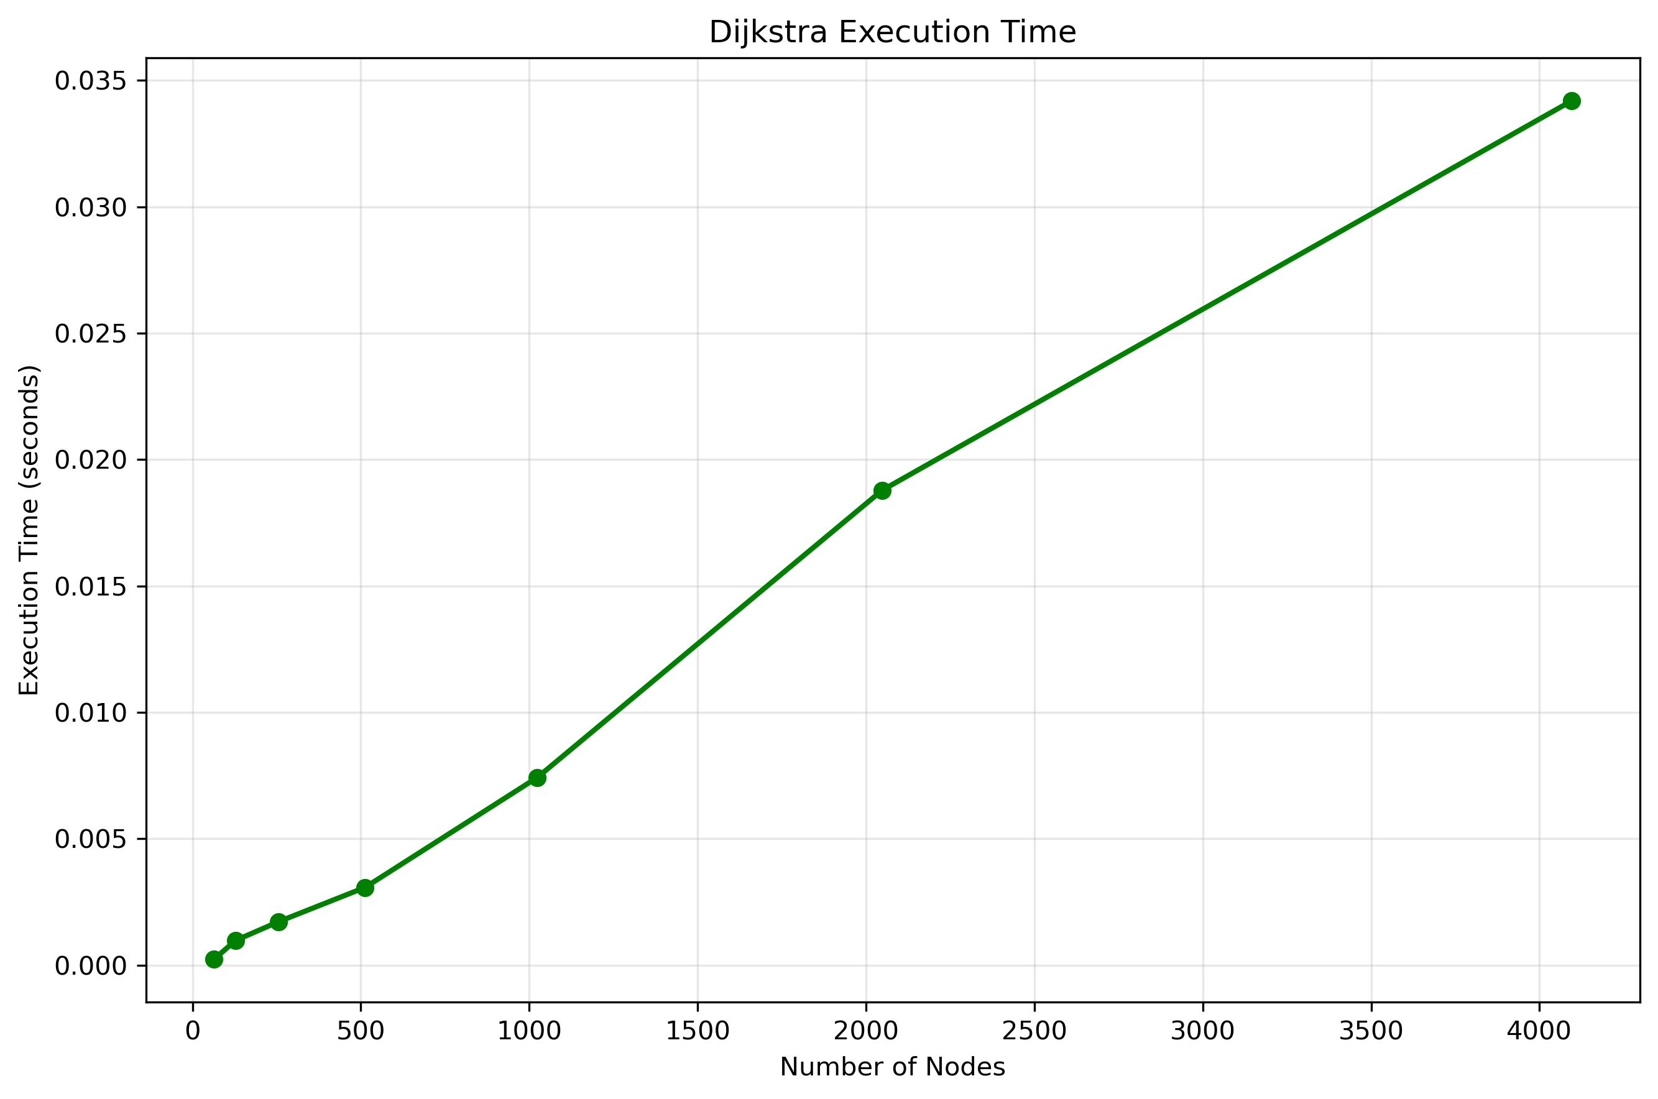
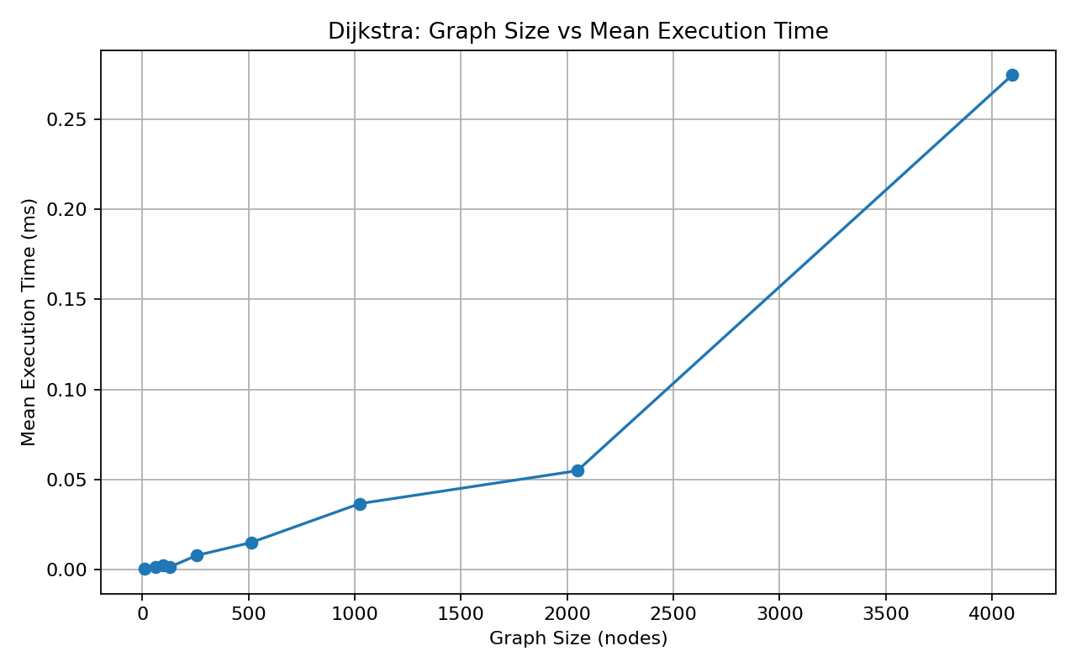
Dijkstra Graph Runtime Code Analysis
Python Implementation
C++ Implementation

Slide 9
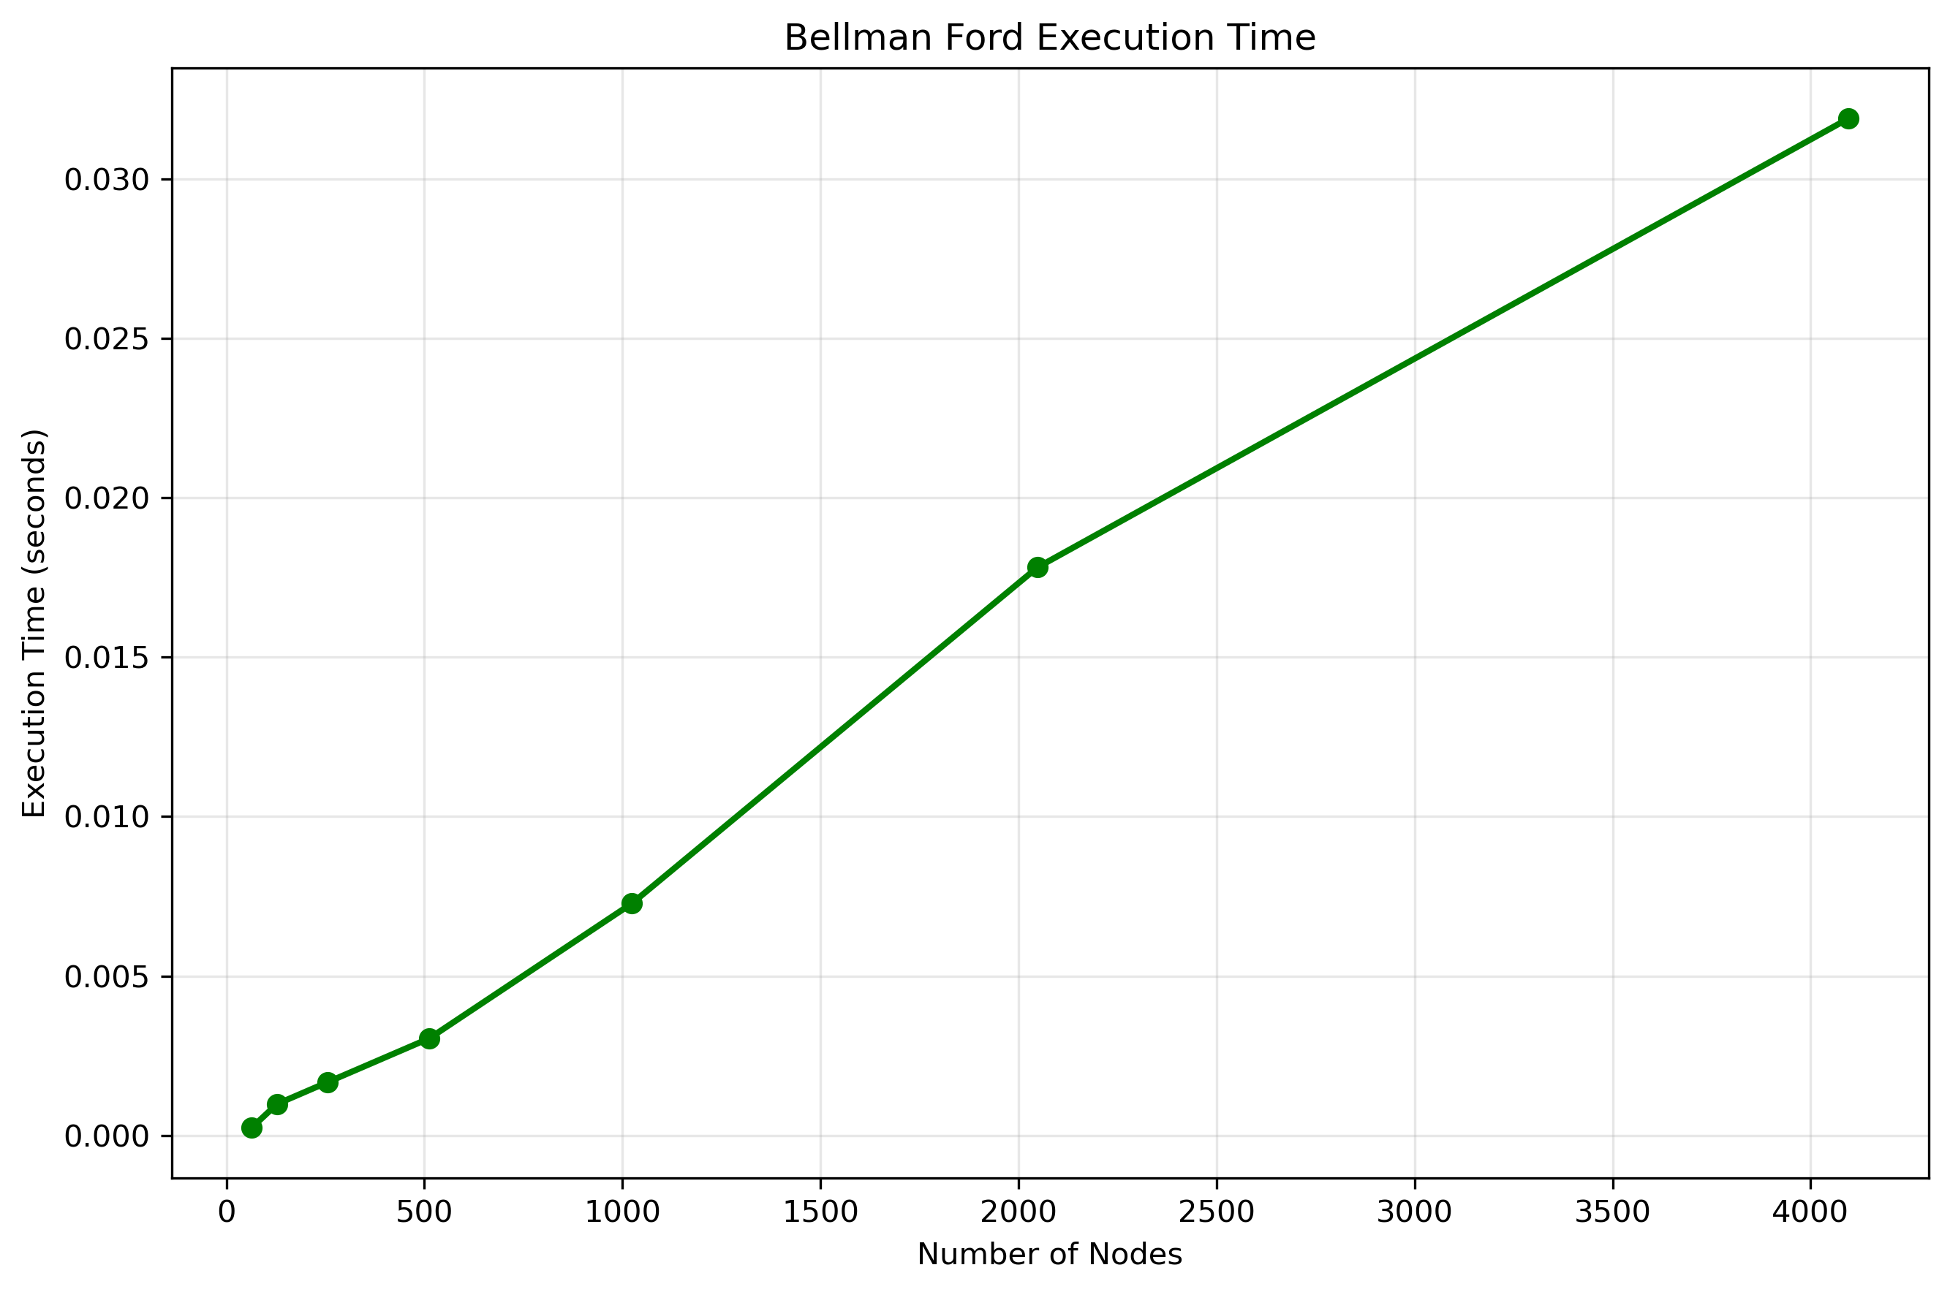
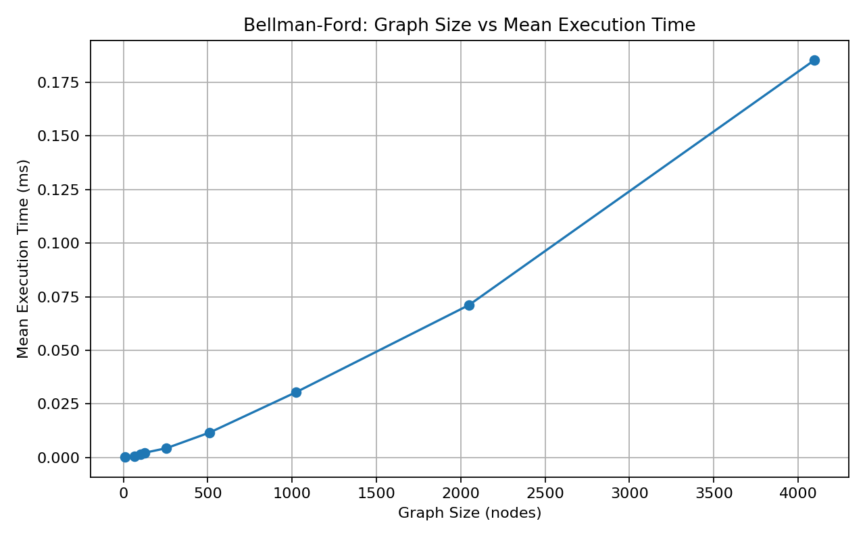
Bellman Ford Graph Runtime Code Analysis
Python Implementation
C++ Implementation

Slide 10
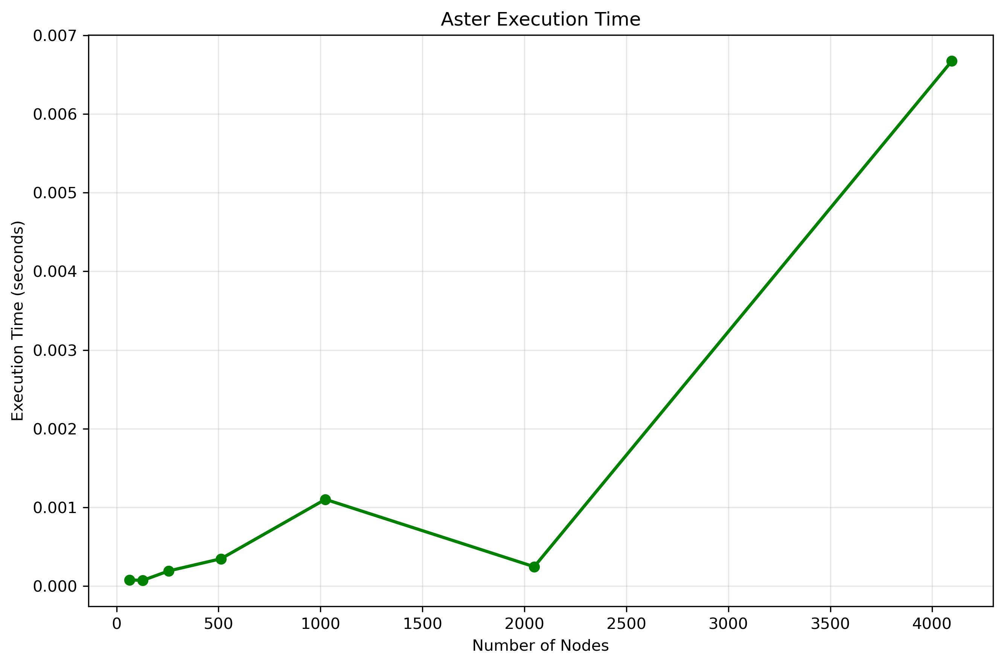
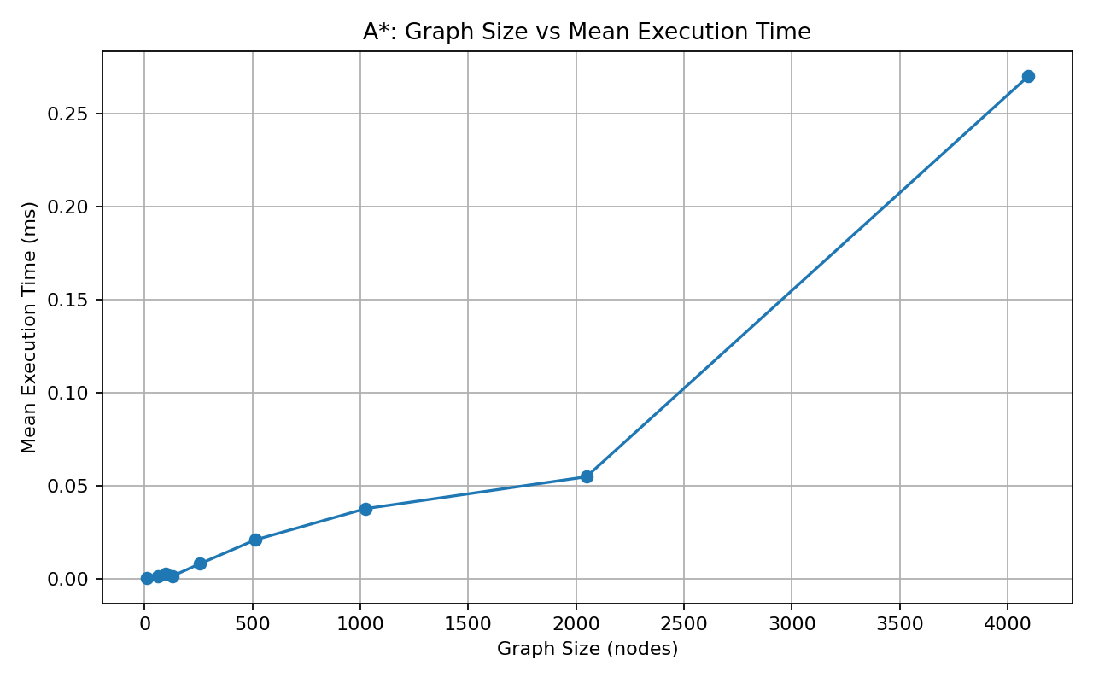
A* Search Graph Runtime Code Analysis
C++ Implementation
Python Implementation

Slide 11
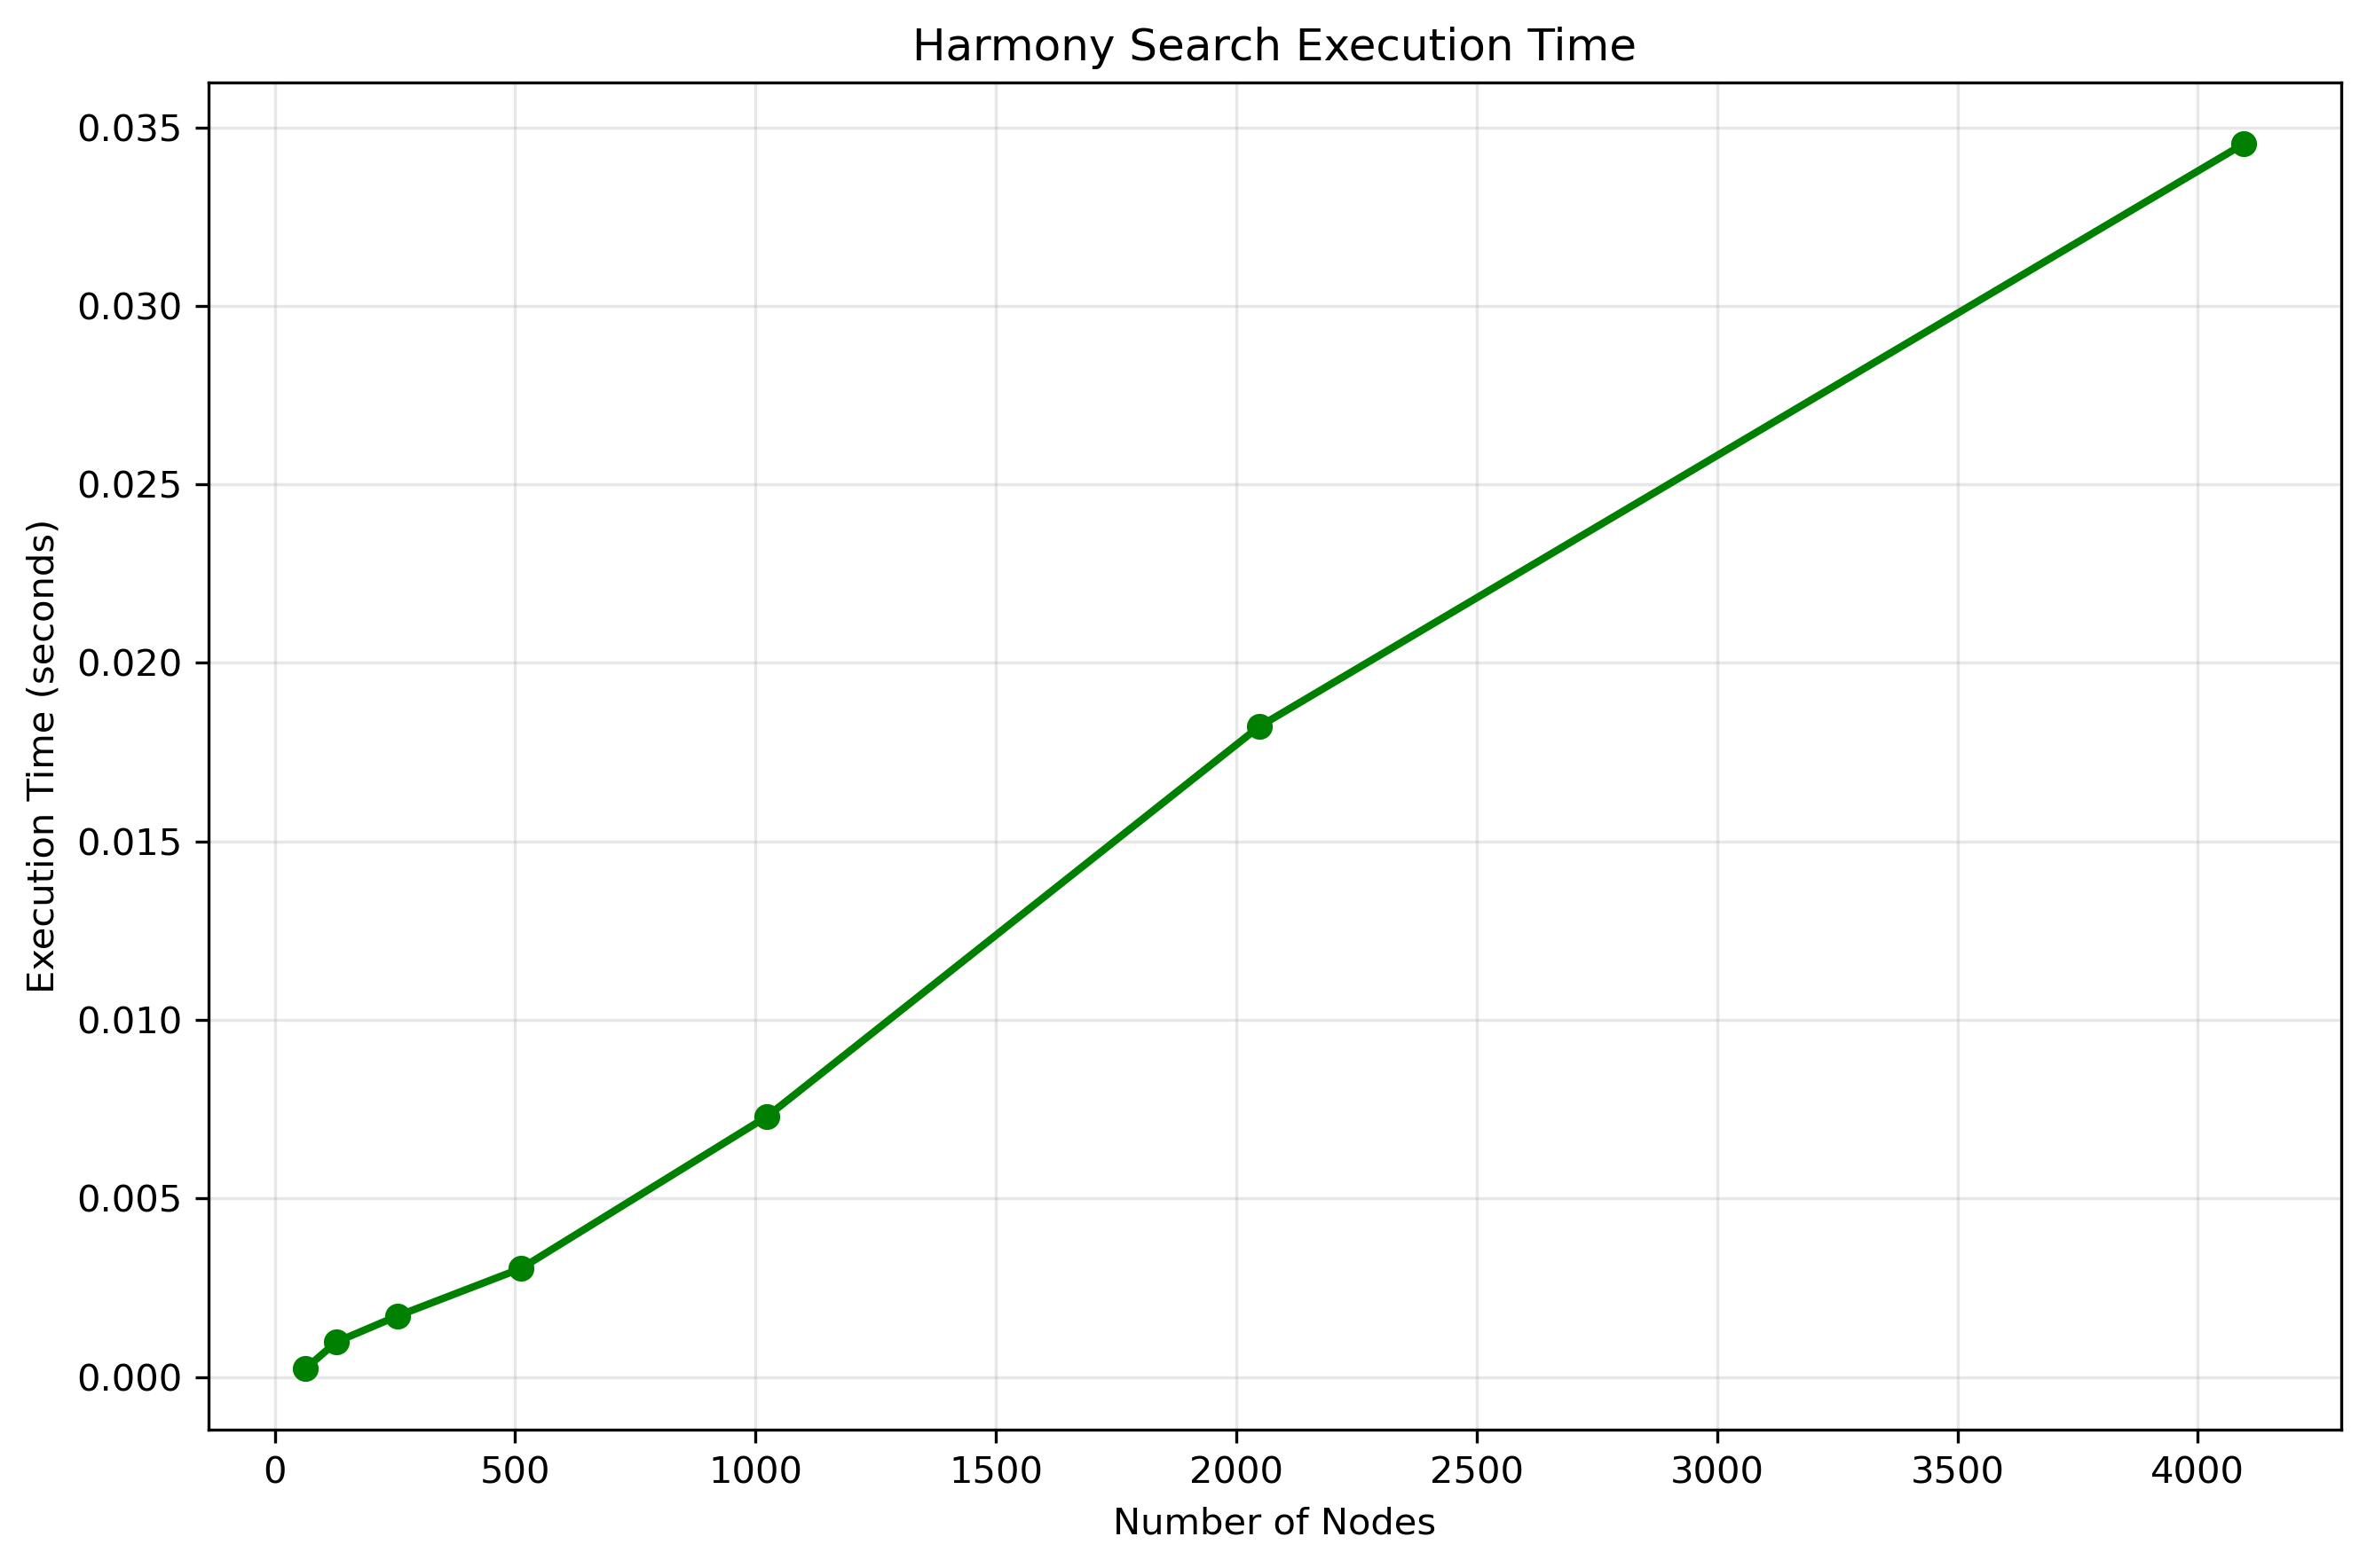
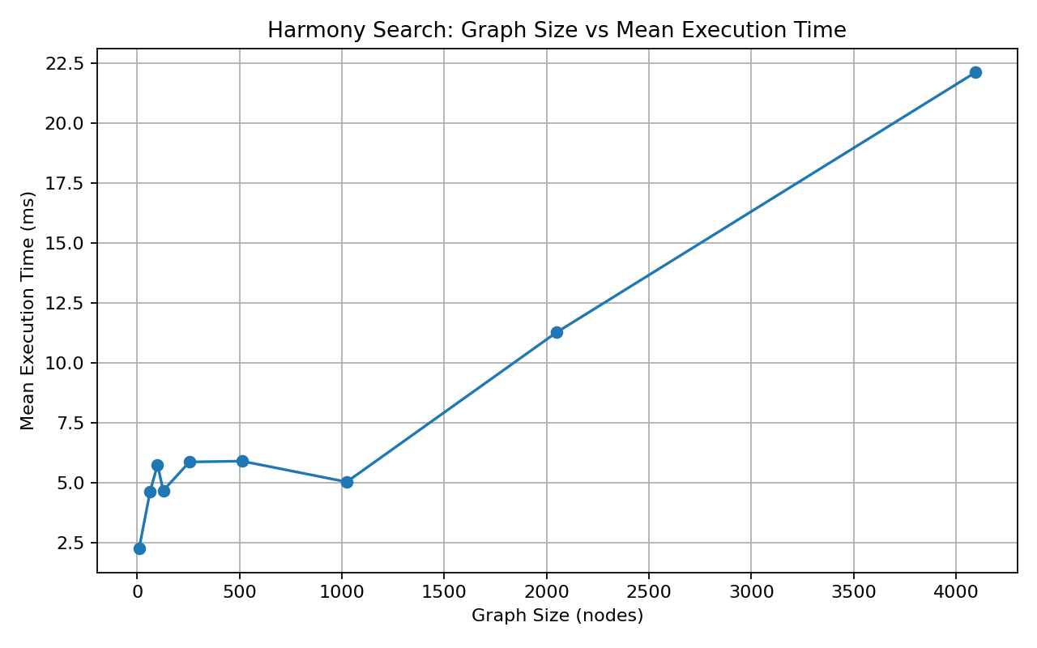
Harmony Search Graph Runtime Code Analysis
Python Implementation
C++ Implementation

Slide 12
Algorithm Comparisons with Real-World Networks
We will be using three real world networks from the Stanford Large Network Dataset Collection to compare our algorithms.
Network | Domain | Nodes Used | Edges Used | Average Degree
ego-Facebook | Social | 4,039 | 88,234 | 43.69
Oregon-1 autonomous systems (2001-03-31) | Internet Routing | 8,000 | 18,074 | 4.52
roadNet-PA | Road Network | 8,000 | 11,916 | 2.98

Slide 13
Algorithm Comparison Notes
The edge weights are synthetic. SNAP ships all three graphs unweighted. Since routing needs weights, each edge weight is derived deterministically from a hash of its two endpoint IDs plus a fixed seed (2400), in the range 1–100. The same edge always gets the same weight, so the runs are reproducible.
Two of the three are subsamples. ego-Facebook is the complete graph (all 4,039 nodes). Oregon-1 (10,670 nodes) and roadNet-PA (1,088,092 nodes) were reduced to 8,000 nodes each with a breadth-first sample, which stays connected by construction. That was necessary because Bellman-Ford is Θ(V·E) and the full road network isn't runnable in pure Python. Each graph was tested on one source→target query: the BFS root to the furthest node reached, so the paths aren't trivially short. Per graph: 3 timed runs of each exact algorithm, 10 Harmony Search trials (it's stochastic), plus 1 memory-instrumented run each — 69 rows total.

Slide 14
Algorithm Comparisons- Basic Operations
Harmony search having fewer basic operations is because we are only trying to find a candidate path, not evaluating every single edge.

Slide 15
Algorithm Comparisons- Path Cost
Harmony search having more paths is from it having to evaluate many alternative routes for a complete candidate path, compared to the other algorithms examining individual edges.

Slide 16
Algorithm Comparisons- Peak Memory Usage
Harmony search has the least memory usage hear since it required fewer memory resources during execution time between our algorithms. Even though each computational operation is expensive, it did not need to store much information simultaneously.

Slide 17
Algorithm Comparisons- Runtime
In theory, Bellman-Ford should have the longest running time, but as shown in the graph, Harmony Search has the longest running time. This is because a metaheuristic optimization algorithm, which means it evaluates many candidate paths before converging on a path. This is from each candidate path evaluation being more expensive in each operation than examining single edges in the other algorithms.

Slide 18
AI Disclaimer
AI is used in this project to help give us generalized structures of how our project should look. We use it to help structure our report only to a small degree and our code while filling in the structure with our code. We also used it to help us fit the data into the code, as well as how to structure our graphs.

Slide 19
References
[1] Jure Leskovec, “Autonomous systems by Skitter”, Stanford University https://snap.stanford.edu/data/as-Skitter.html
[2] Dijkstra's Algorithm, https://www.geeksforgeeks. /dsa/dijkstras-shortest-path algorithm-greedy-algo-7/
[3] Levitin, Anany. "“Introduction to the Design and Analysis of Algorithms”, Pearson Education, 2012." (2015).
[4] Bellman-Ford Algorithm, https://www.geeksforgeeks.org/dsa/bellman-ford algorithm-dp-23/
[5] A* Search Algorithm, https://www.geeksforgeeks.org/artificial-intelligence/a algorithm-and-its-heuristic-search-strategy-in-artificial-intelligence/
[6] Geem, Z. W., Kim, J. H., & Loganathan, G. V. (2001). "A New Heuristic Optimization Algorithm: Harmony Search." Simulation, 76(2), 60–68. DOI: 10.1177/003754970107600201

